Slide 1
Coherent-Event analysis
Definition
Determine overlapping spindle events between
FRO – PAR
FRO – CA1
PAR – CA1
Additionally check whether these coherent events contain an offline-detected ripple event
FRO-Spi
CA1-Spi
CA1-Ripple
Coherent FRO-CA1
spindle event
Coherent FRO-CA1
Spindle-ripple event

Slide 2
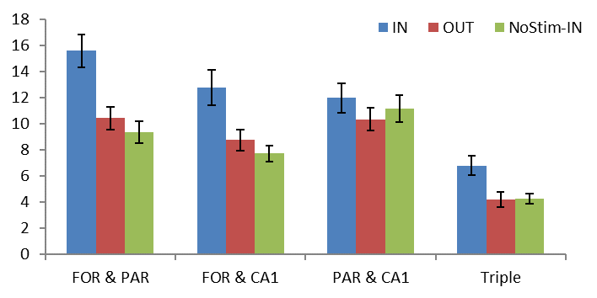
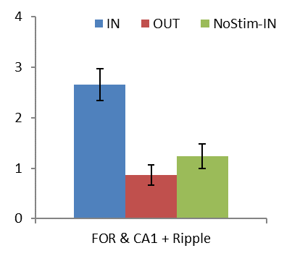
Slow spindles
Incidence rate (%)
Only In-phase stimulation increases probability of frontal-parietal, frontal-hippocampal and global spindle events
Same holds for frontal-hippocampal events including ripples

Slide 3
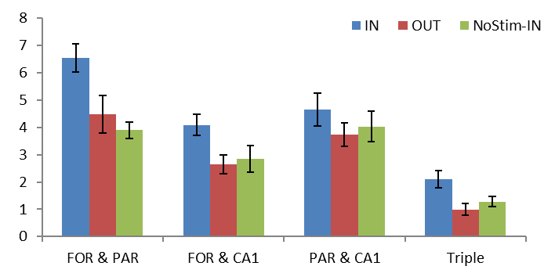
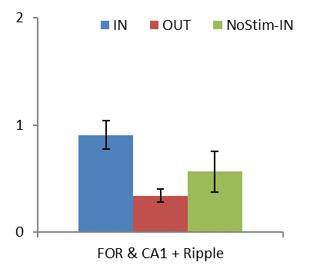
Broadband spindles
Incidence rate (%)

Slide 4
Coherent-Event analysis
Analysis - Cross-Covariance
Determine delay between frontal and hippocampal spindles
Use window +/- 100 ms spindle range
Due to low number of cases events are pooled across all mice for each condition
100 ms
100 ms
FRO-Spi
CA1-Spi
Spindle range
Analysis window

Slide 5
Coherent-Event analysis
Analysis – Ripple-locked analysis
Select ripples within frontal-hippocampal spindle events
Average raw FRO and CA1 EEG-signal and signal filtered in spindle band
Determine the phase ripples occur within spindles
Time-frequency plots of spindle troughs
Analysis also performed over pooled data

